Slide 1
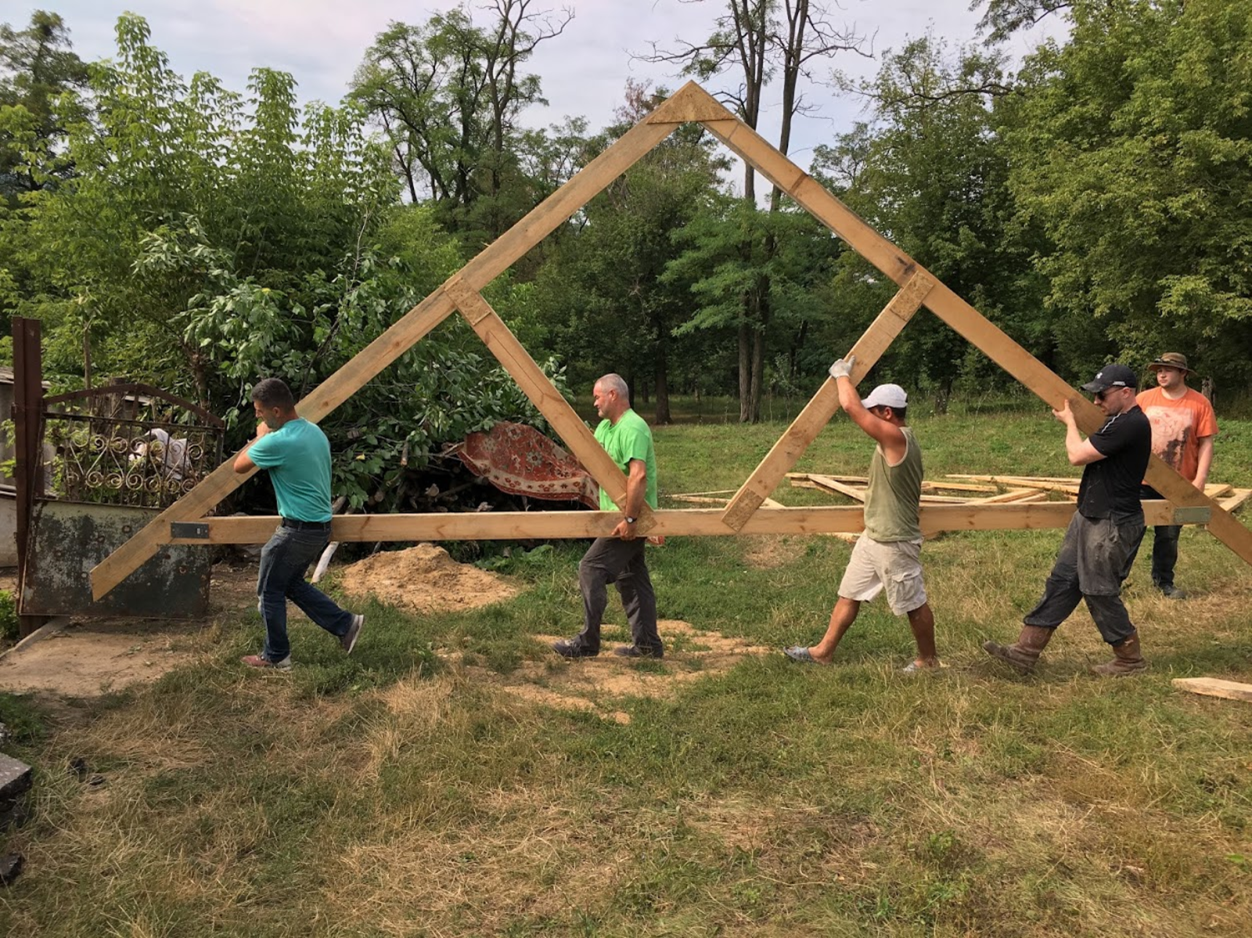
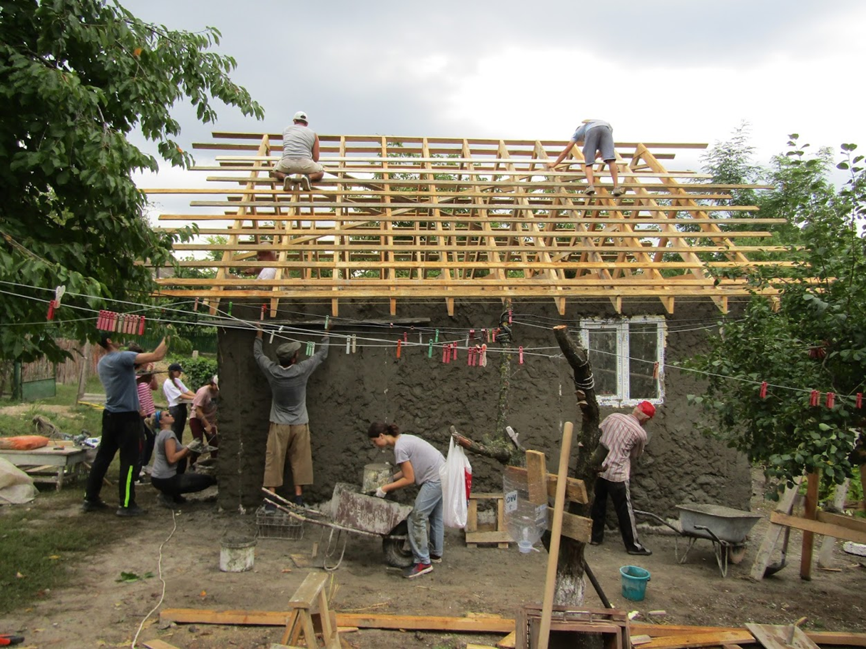
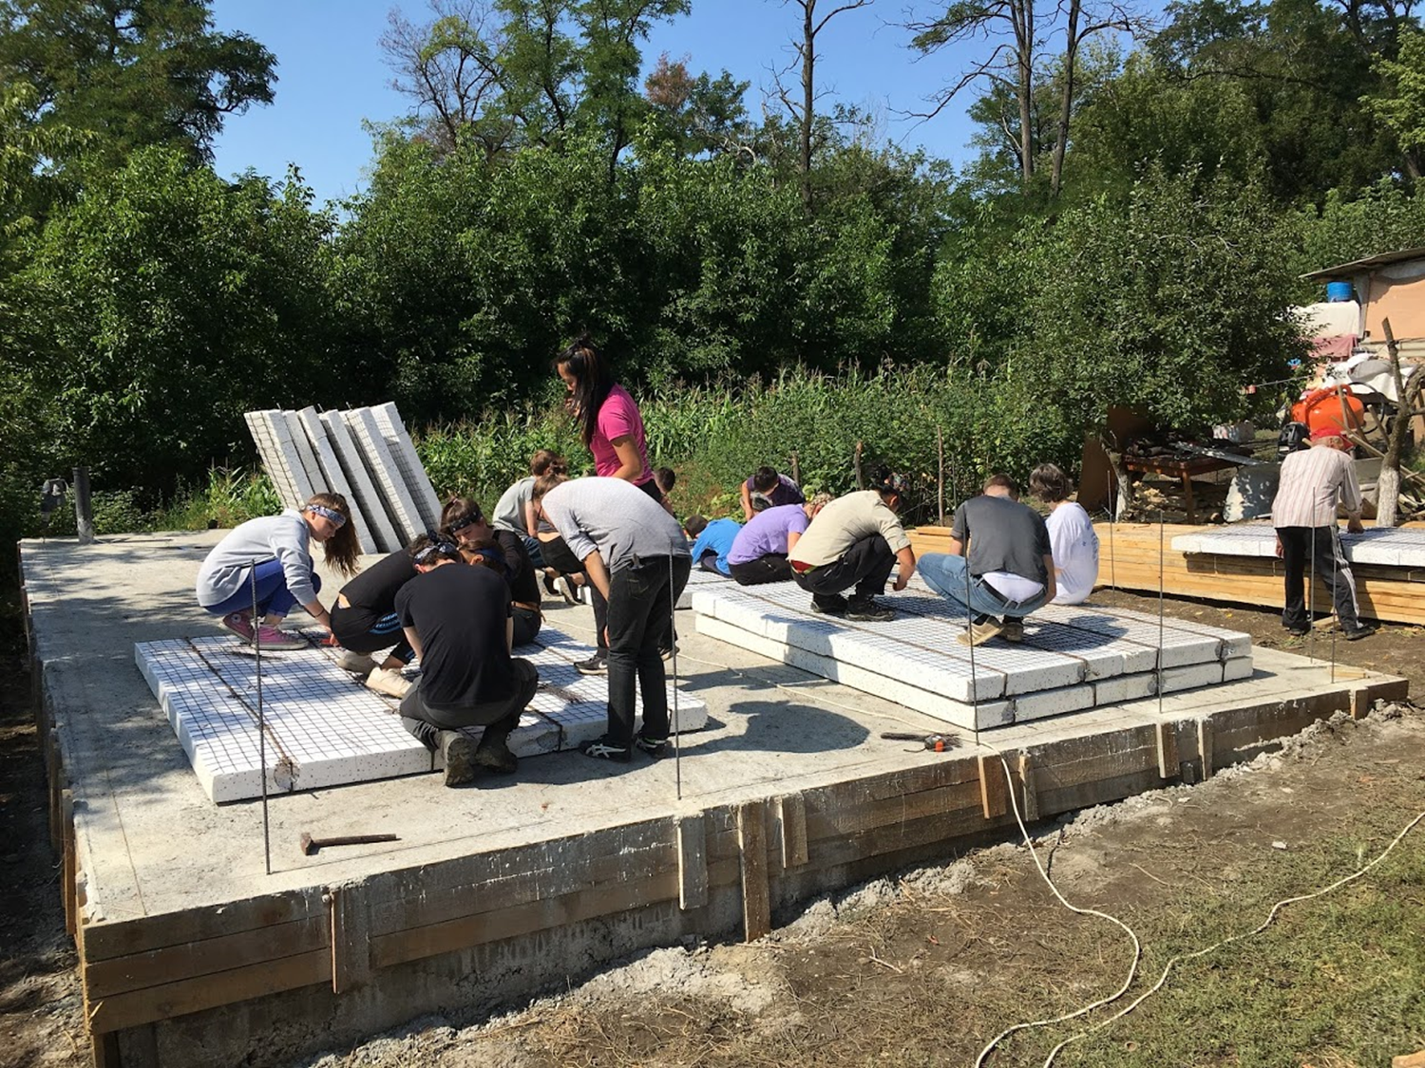
Build Home
Moldova
Sat 27 July to Sun 4
August 2024

Slide 2
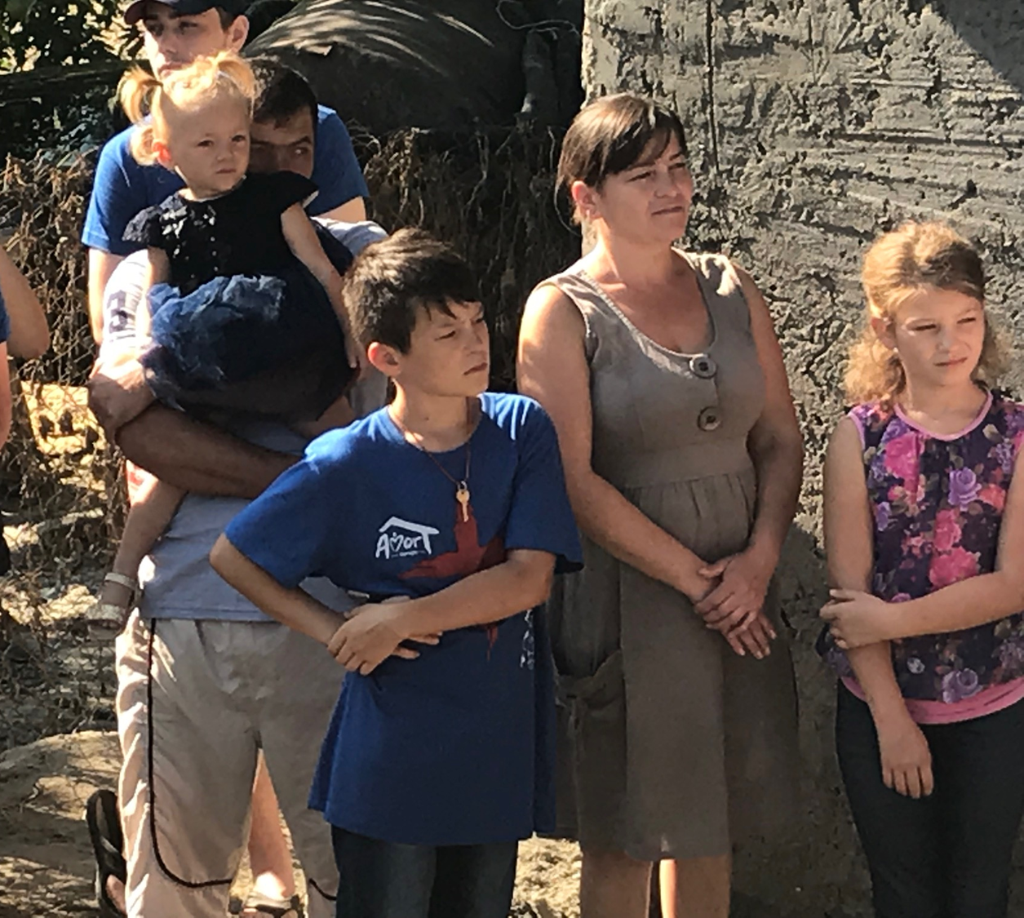
Building a new home…
for a family trapped by poverty

Slide 3
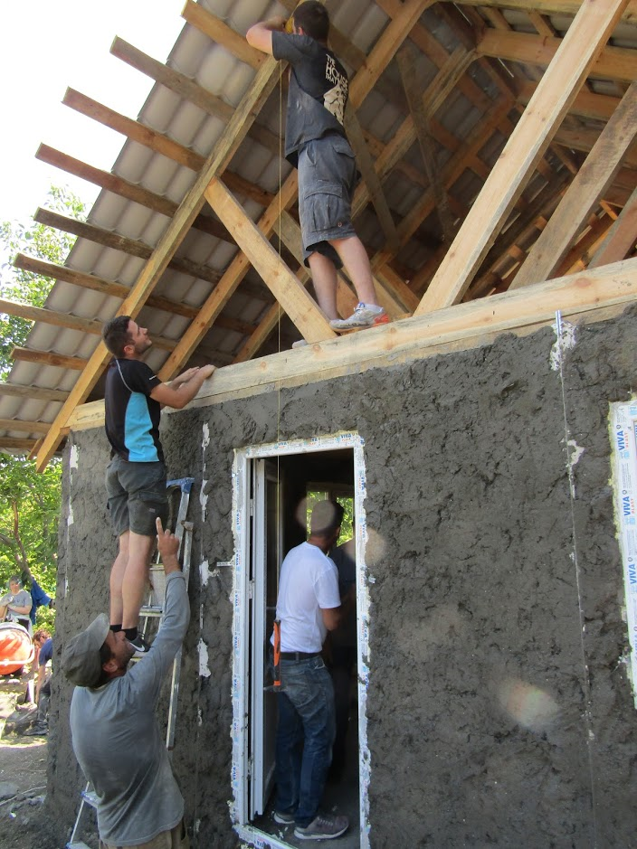
Be part of a team of English, German and Moldovan young people who will build a house in just 5 days…

Slide 4
…and bring transformation to the lives…
of a family living
in Moldova

Slide 5
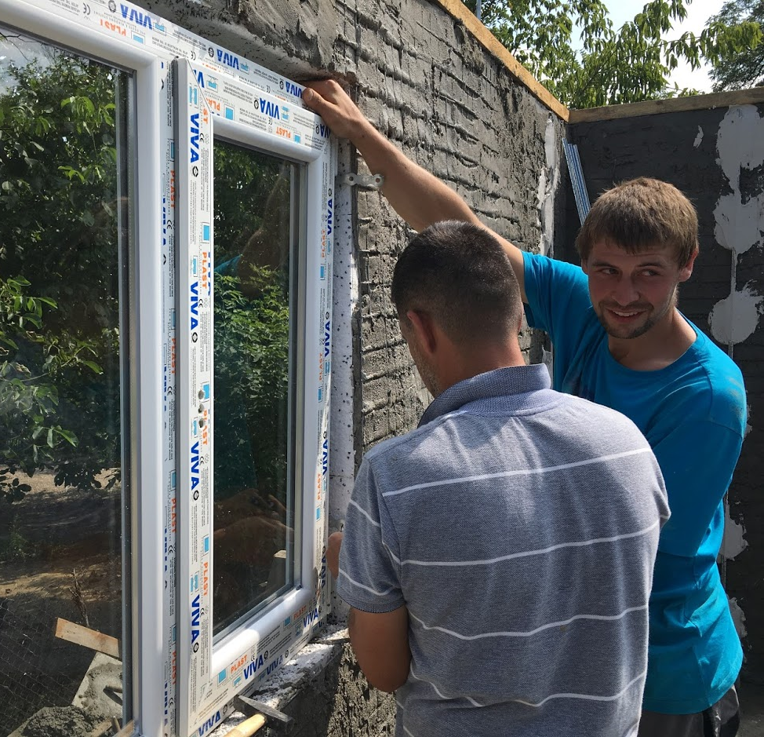
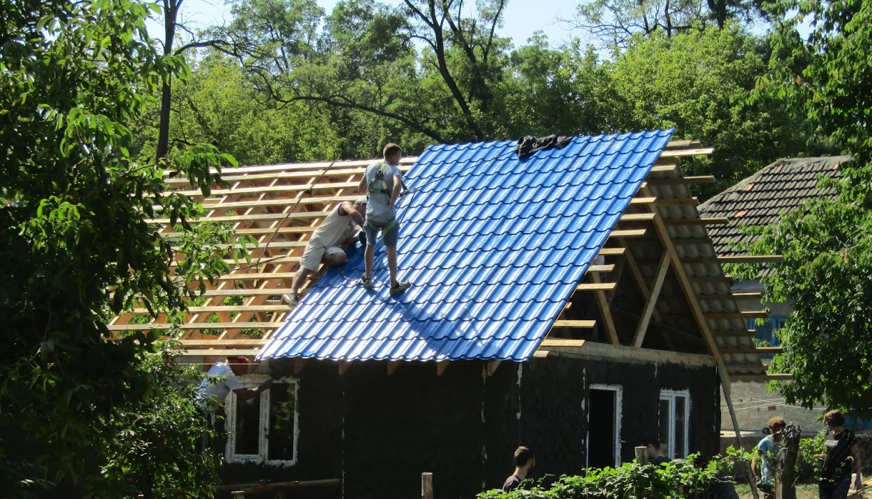
Facts about Moldova
Moldova is the poorest country in Europe
Moldova is the least visited country in Europe
Moldova has the largest wine cellar in the world
Moldova is the second highest alcohol consuming nation in the world
Many of the middle generation have left the country, leaving the elderly and children unsupported

Slide 6
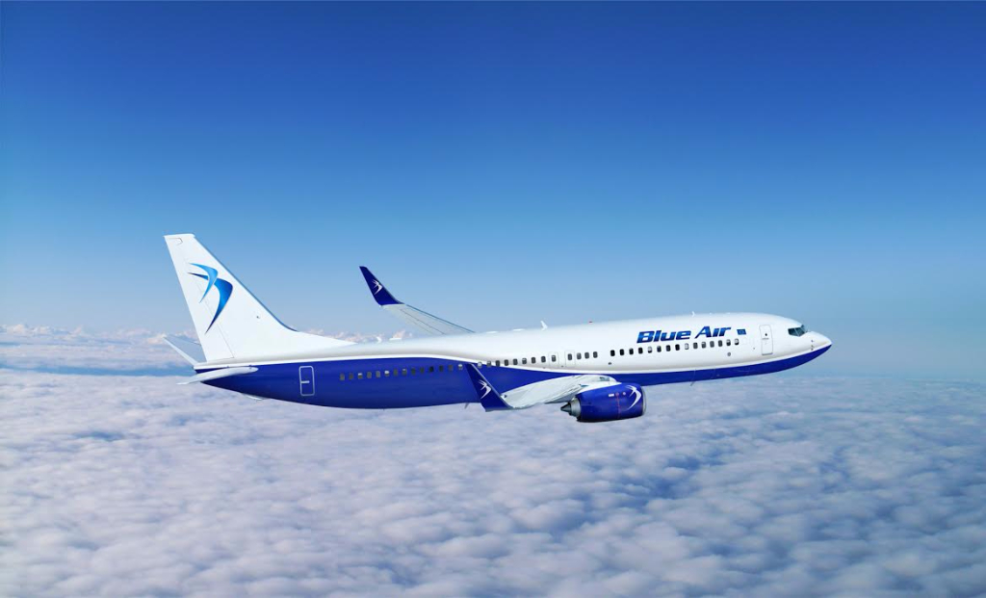
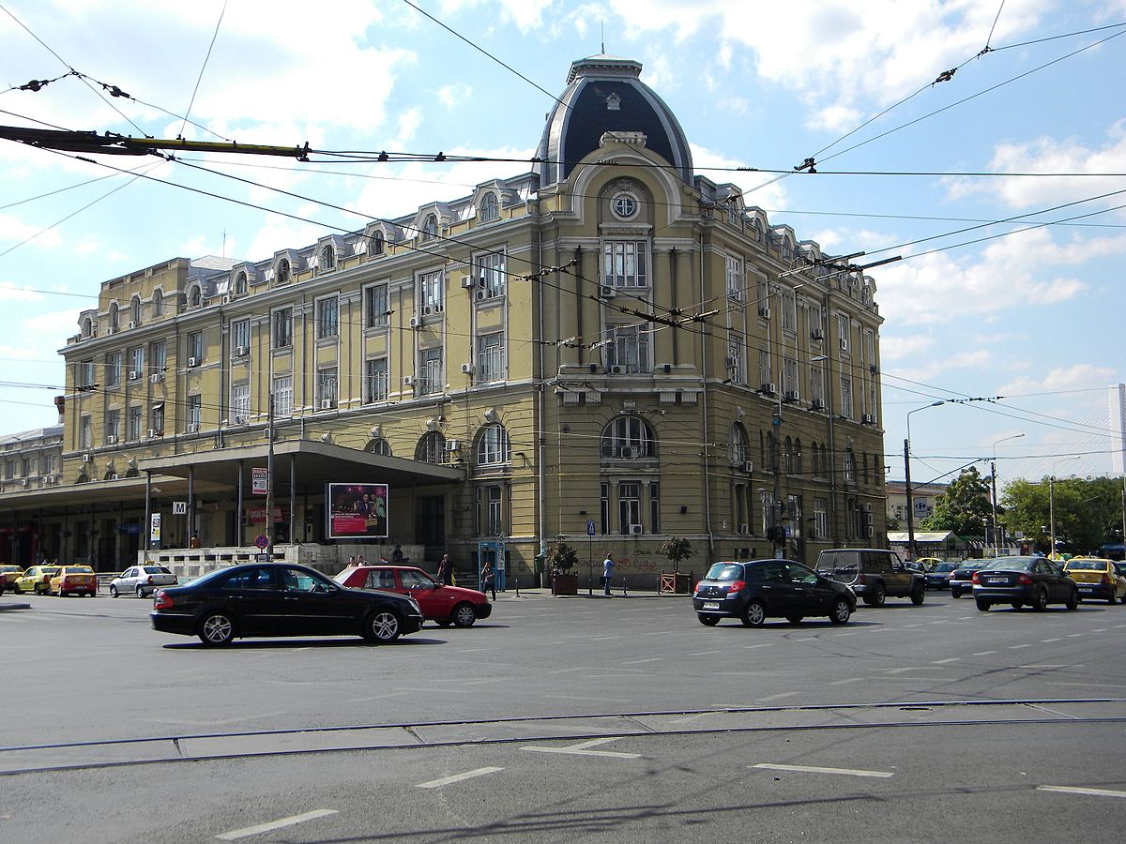
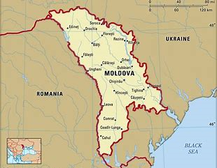
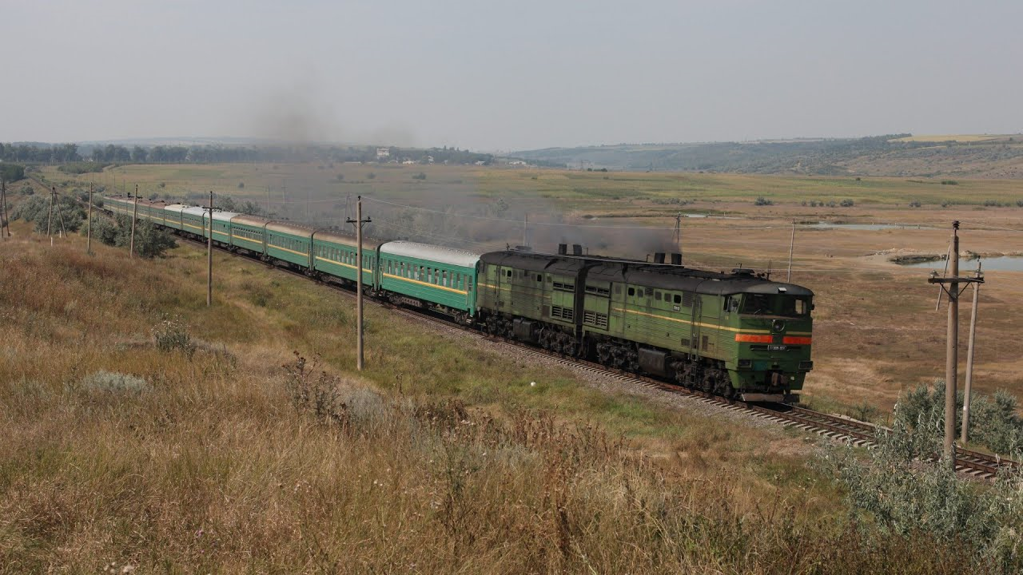
About your trip:
Day1: Travel to Moldova
Fly to Bucharest, Romania
Half day to explore the capital
8-hour sleeper train to Moldova fully equipped with beds
Day 2: Arrive in Moldova
Arrive in Ungheni, Moldova in time for breakfast
Orientation & training day
Meet the Moldovan young people and visit the village you will be building in

Slide 7
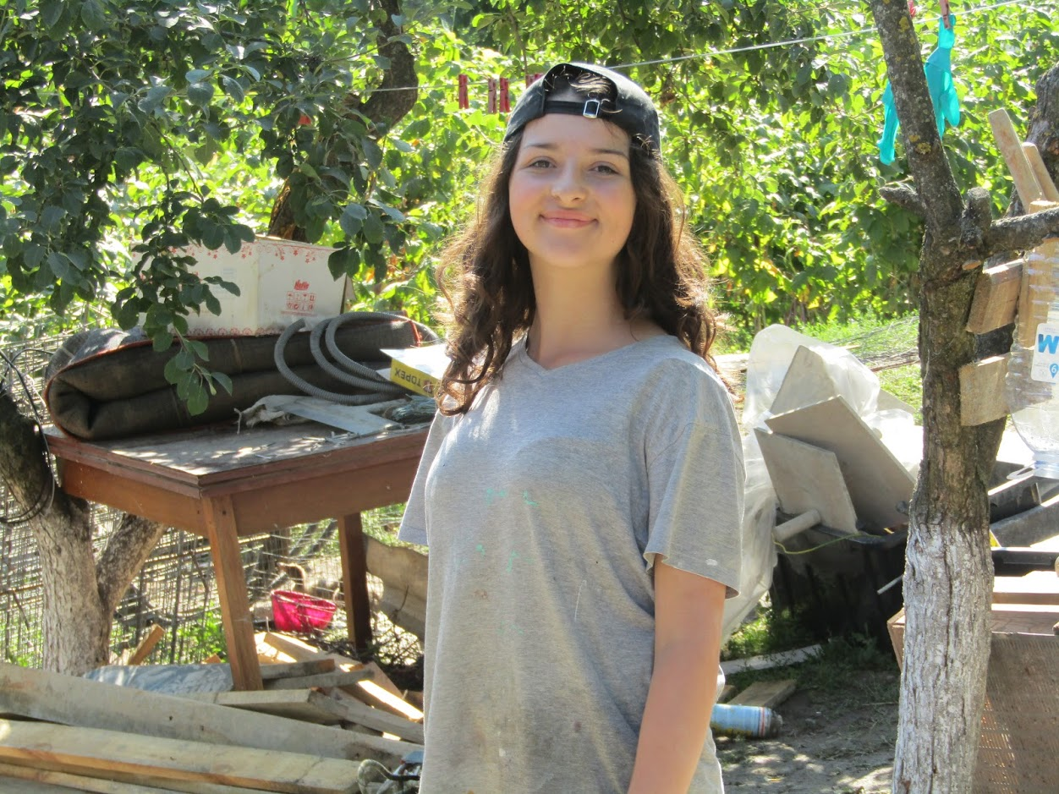
About your trip
Day 3 to 7: House Building
Build a house in just 5 days
Take part in additional activities to serve the community
Give the keys to the family (a moment you will remember for the rest of your life)
Day 8: A well deserved day off
Shopping, swimming and barbecue at Ungehni
Night train to Bucharest
Day 9: Fly back to the UK

Slide 8
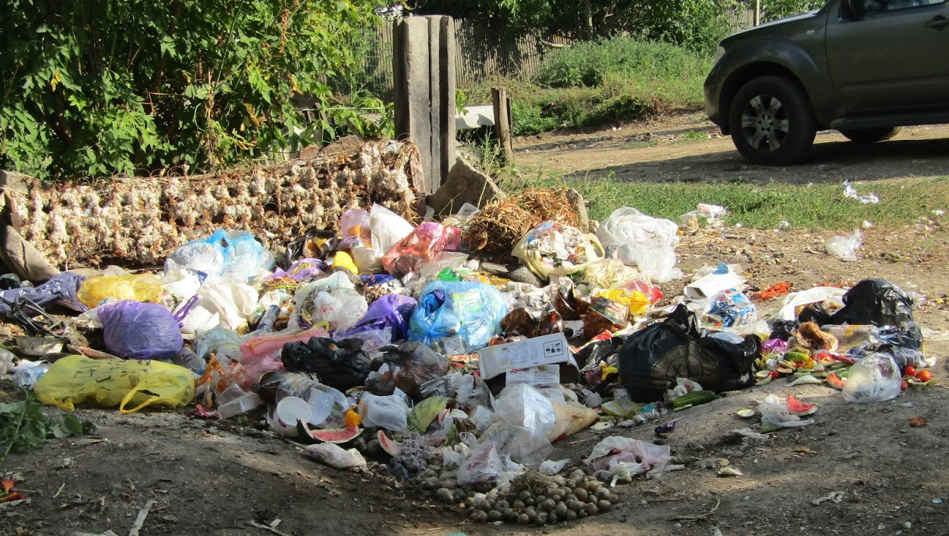
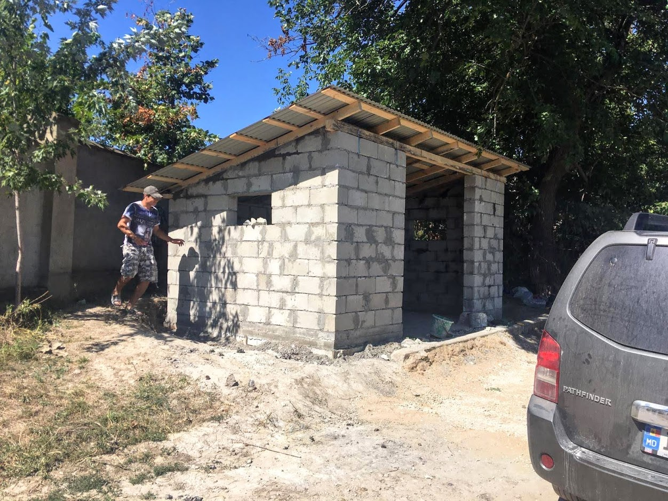
Before
In addition to building a house, we will explore other ways of serving people in Moldova.
The 2019 team built a refuse collection point in the village
We also visited an orphanage, cleared a garden and prayed for people in the community
After

Slide 9
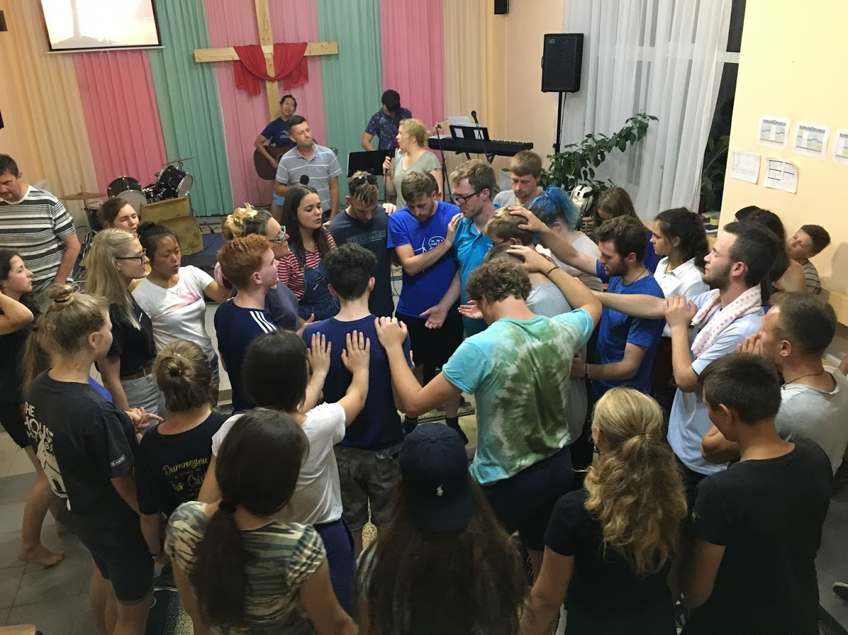
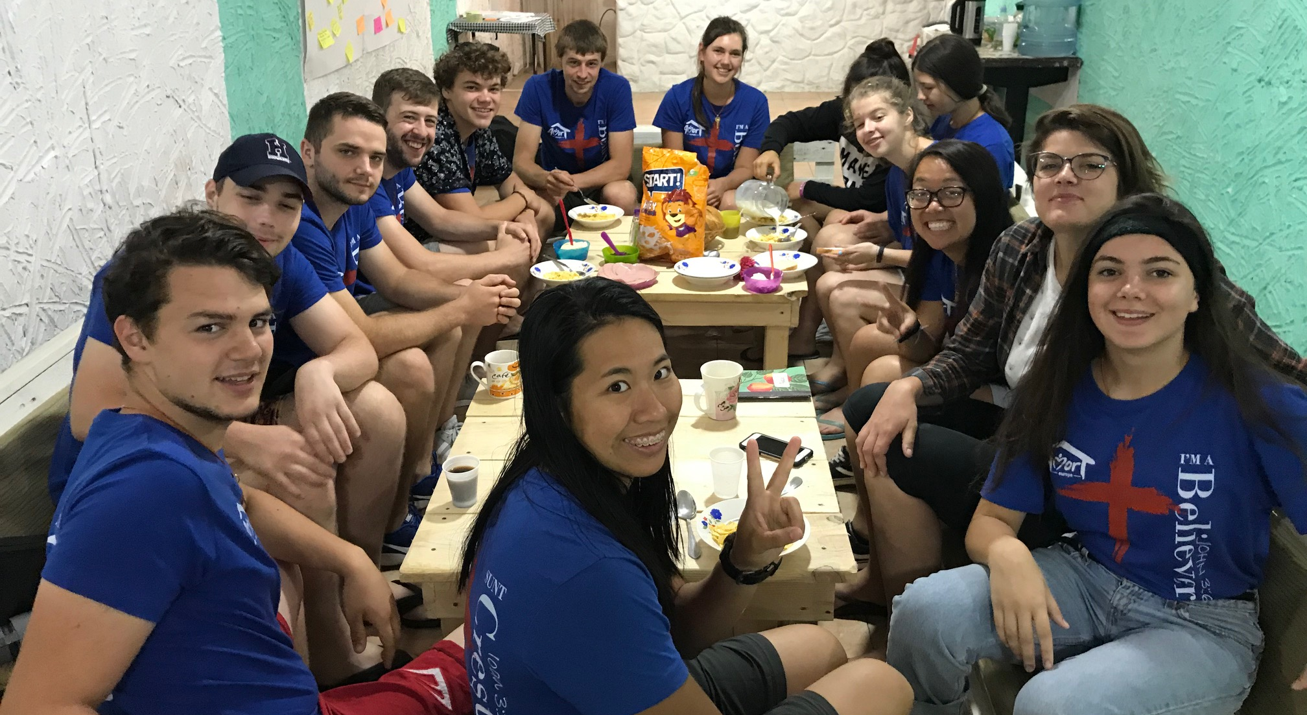
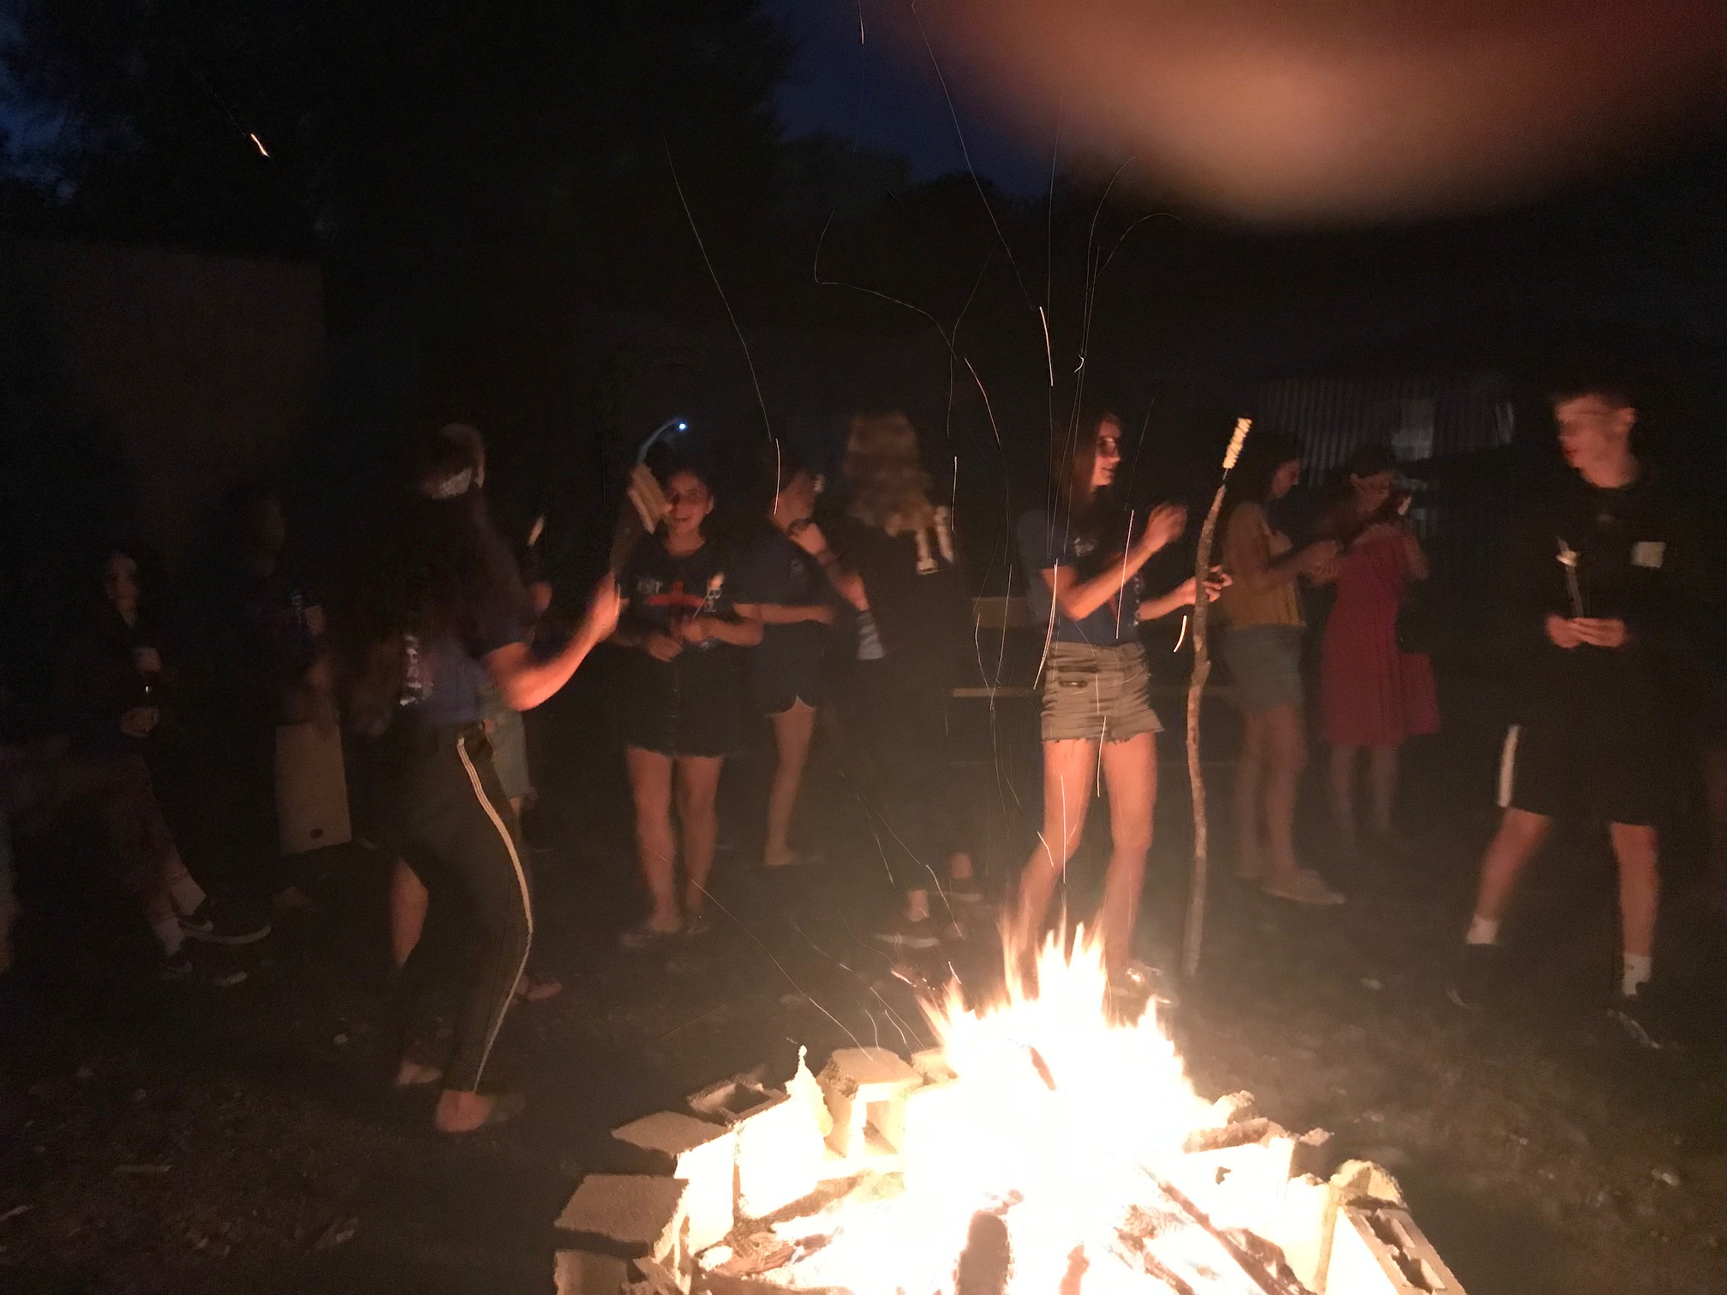
Fast moving, inspiring evening meetings are followed by a chance to relax around a campfire

Slide 10
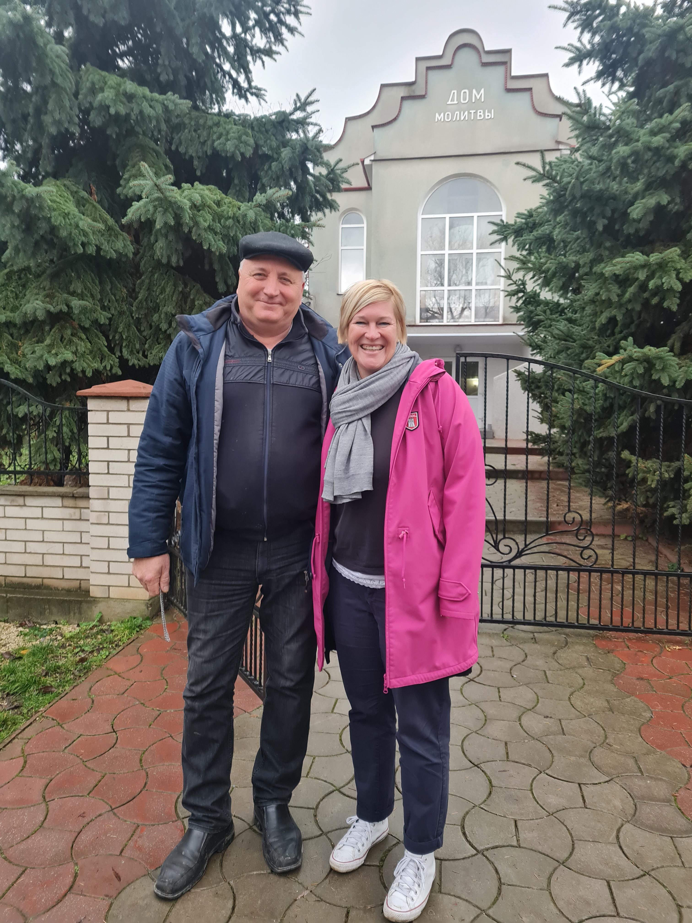
Based in this church with this pastor Victor
Meals
Meetings
Training/briefings
Evi will lead the German team
Living with host families
Working on one or two sites in this village

Slide 11
Highlight
One of the highlights of your
trip will be getting to know the Moldovan young people.
The money you raise, will help to pay for them to be on the team.

Slide 12
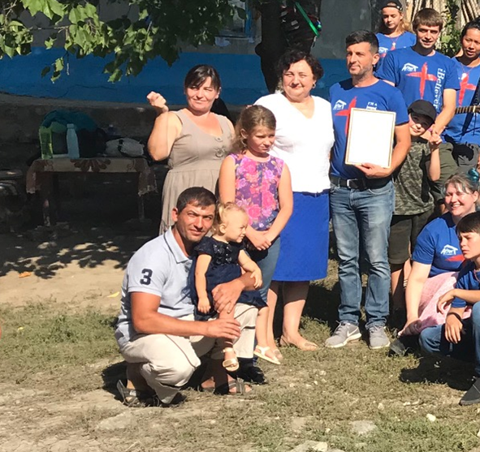
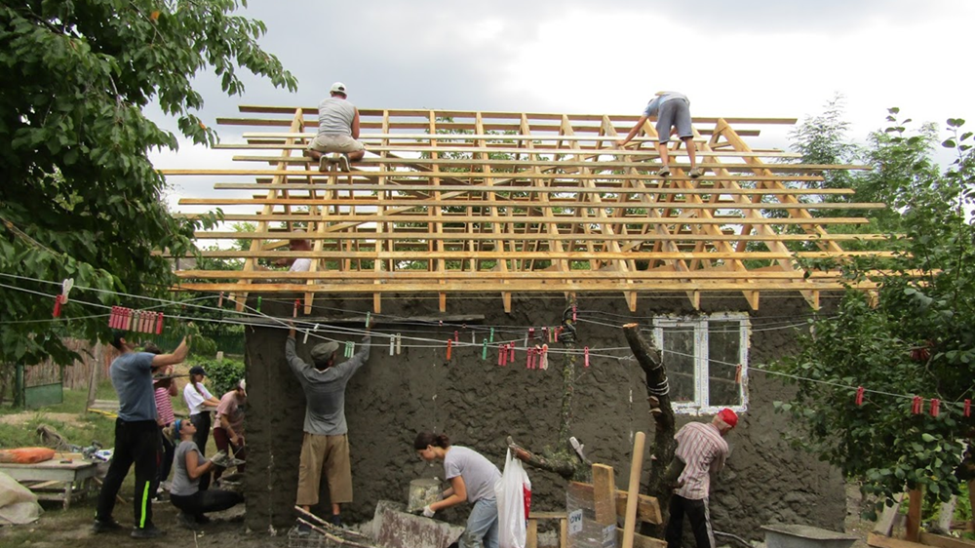
Giving the keys to the family and seeing them walk into their new home for the first time, will be a moment you will remember for the rest of your life

Slide 13
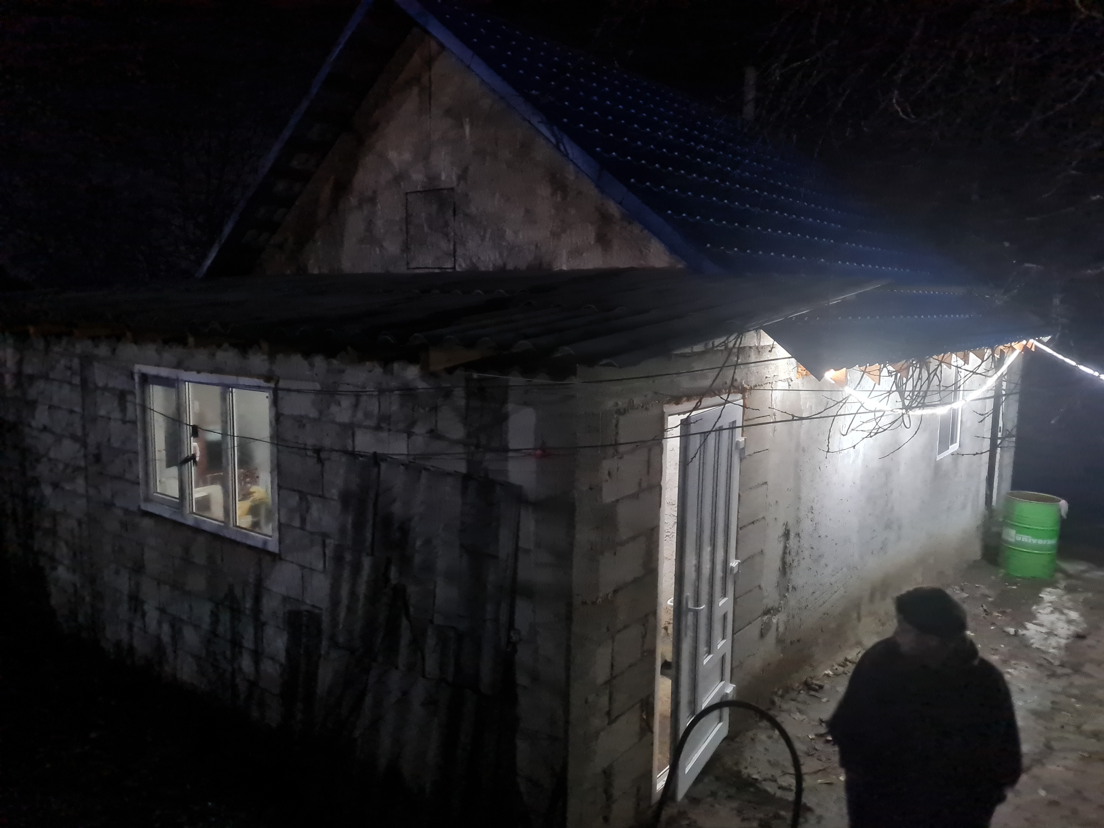
2019 BUILD Home Moldova
Both parents have jobs
House well furnished
Kids well clothed
Spotlessly clean
Well decorated

Slide 14
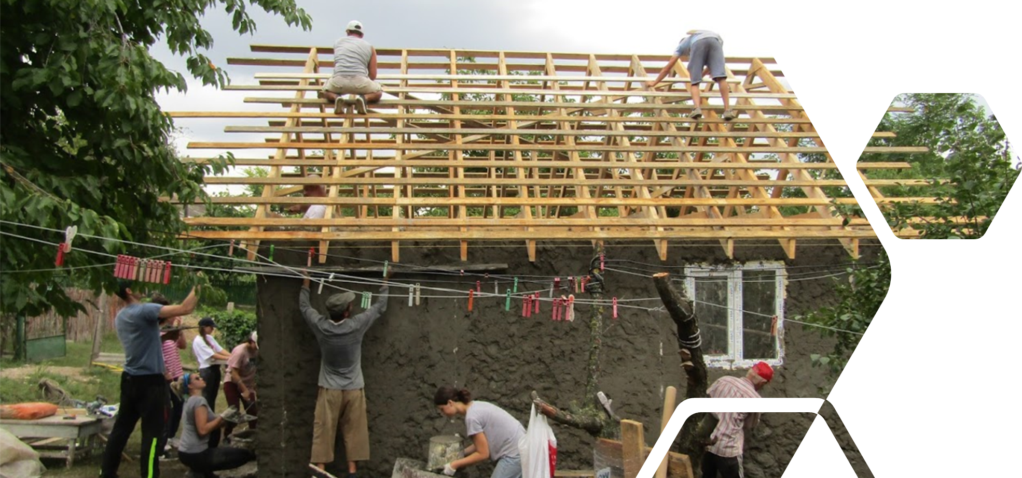
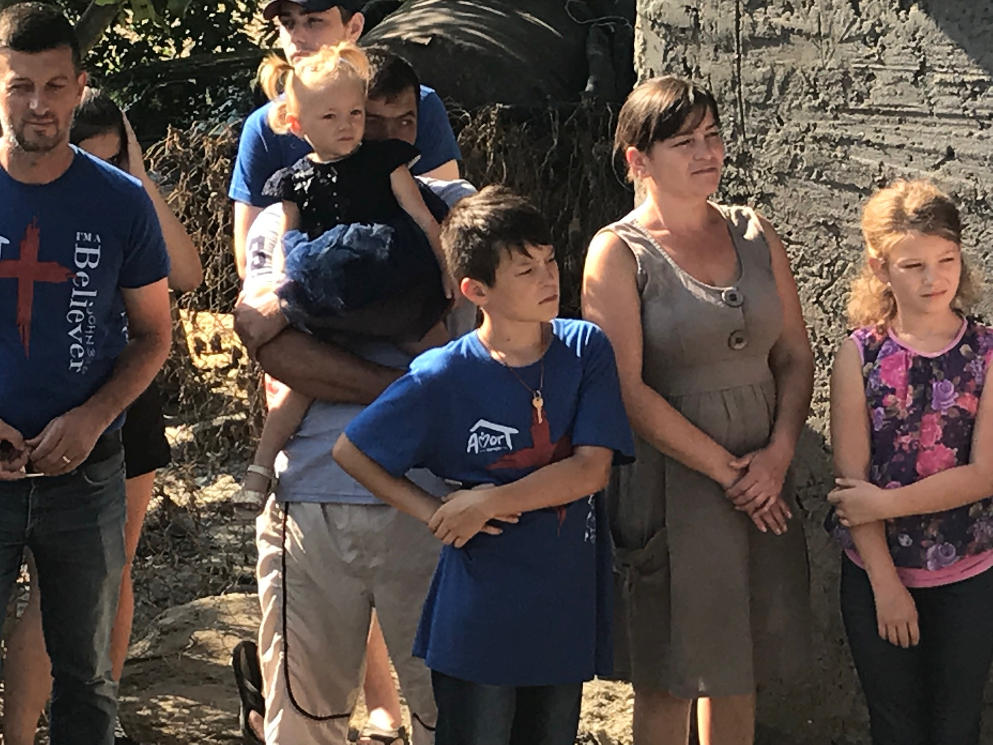
Build a home for a Moldovan family trapped by poverty…

Slide 15
…and experience your own life transformed by God’s love

Slide 16
Build Home
Moldova 2024
Sat 27 July
to
Sun 4 August

Slide 17
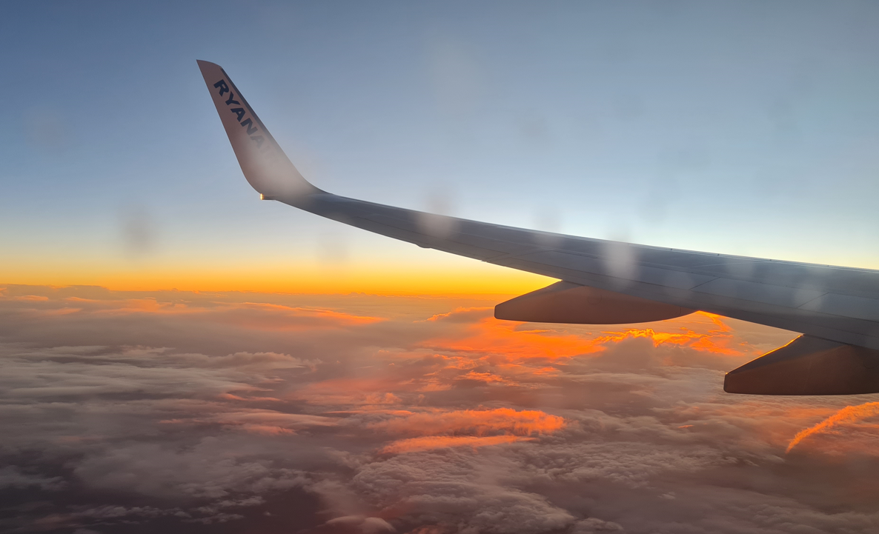
Use this space to update your own local application process

Slide 18
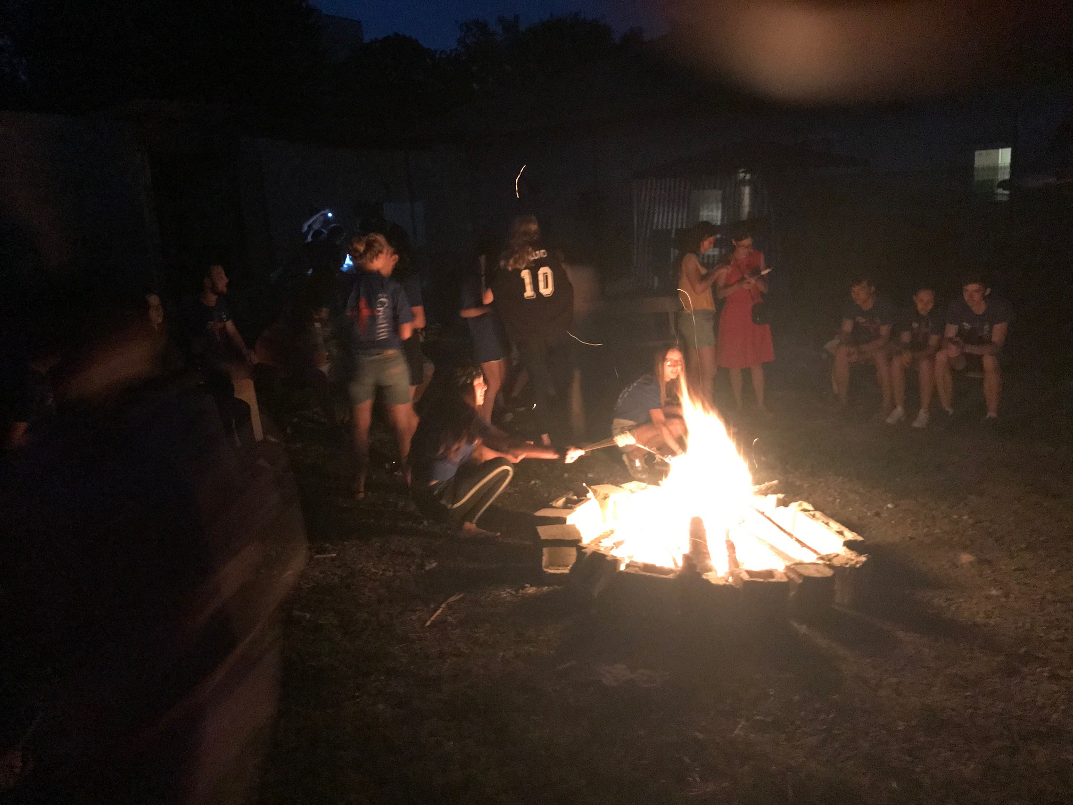
Build Home
Moldova 2024
Sat 27 July – Sun 4 Aug 2024
Pack your bag and come with us on a journey you will remember for the rest of your life

